Slide 1

Lab 05 USART & ADC
Prof. Davide Brunelli
Dept. of Industrial Engineering – DII
University of Trento, Italy
davide.brunelli@unitn.it

Slide 2
USART
USART

Slide 3

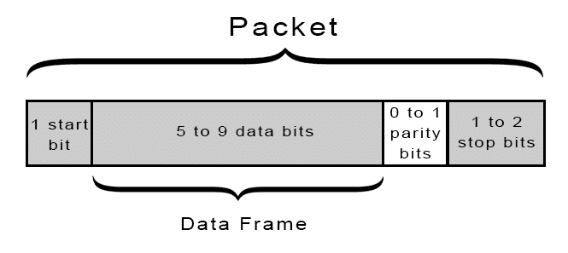
STM32 USART
Universal synchronous and asynchronous receiver-transmitter (USART) is a type of serial interface device that can be programmed to communicate asynchronously or synchronously.
The serial communication in asynchronous mode is one of the simplest and most used methods to exchange data between a microcontroller and other devices.
3

Slide 4
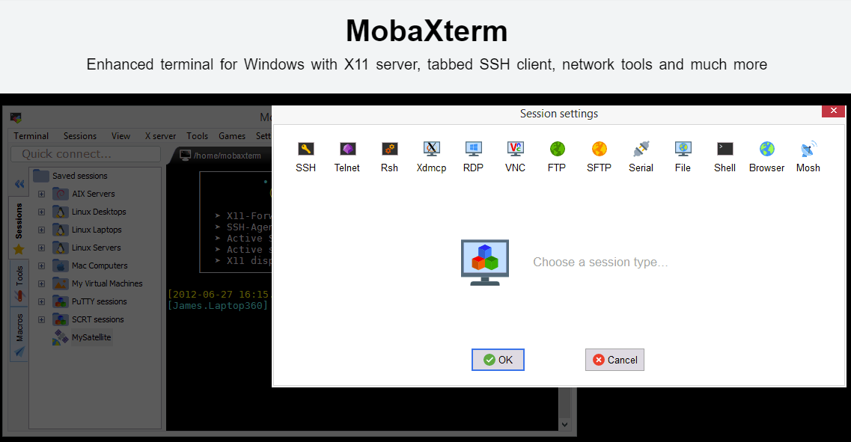
STM32 USART
STM32 MCUs provide USART communication. We can communicate with the Nucleo board by activating USART peripheral. First you need a serial terminal, like MobaXterm. If necessary, download the software from -> https://mobaxterm.mobatek.net/download.html
4

Slide 5
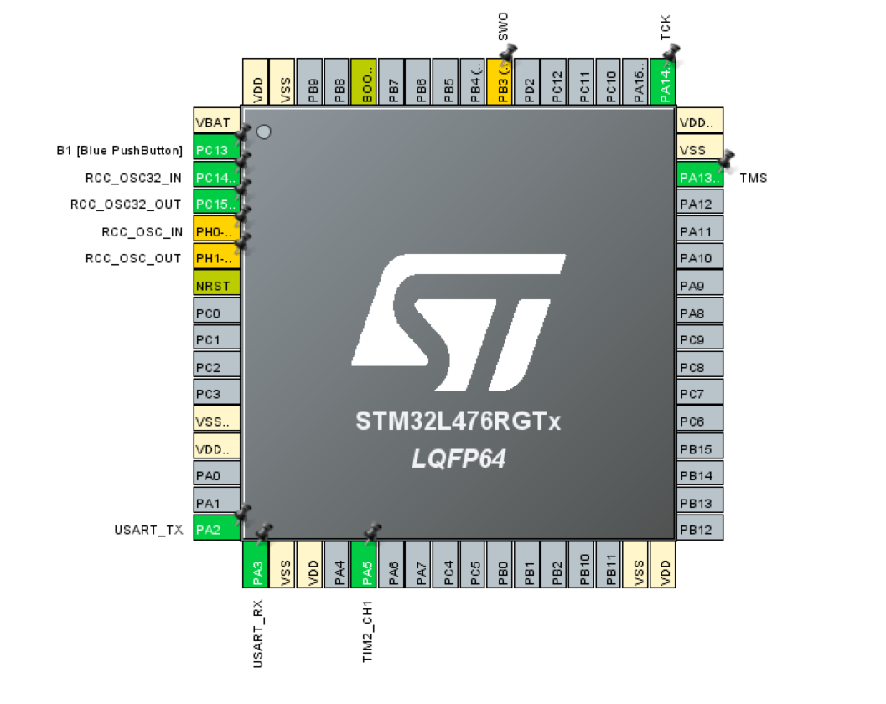
STM32 USART
Nucleo boards directly connect USART RX/TX pins to the mini USB port integrated in the STLink
PA2 = TX
PA3 = RX
5

Slide 6
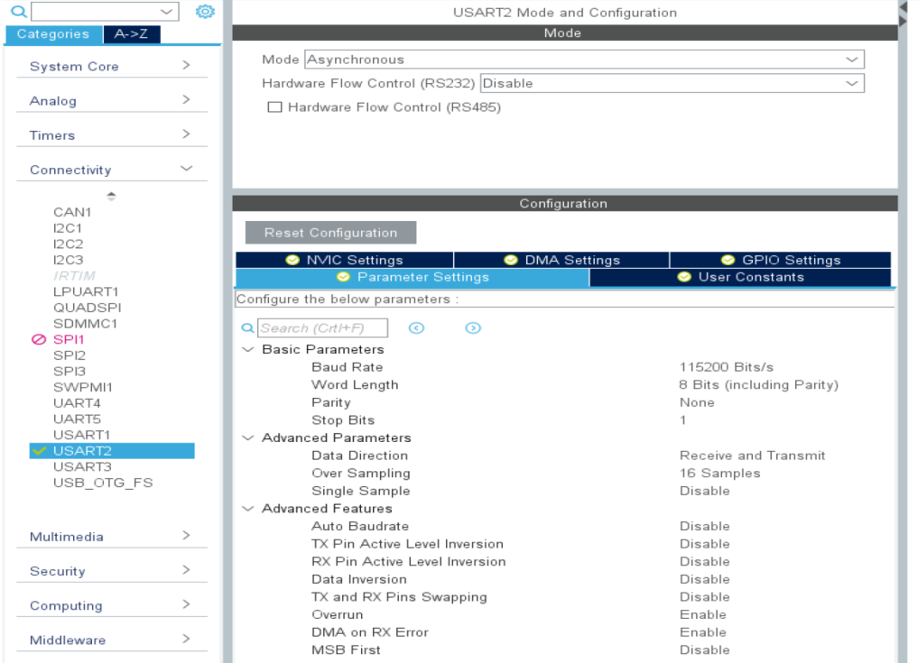
STM32 USART
USART parameters can be configured as always using CubeMX. In our case, we can stick with the default parameters.
6

Slide 7
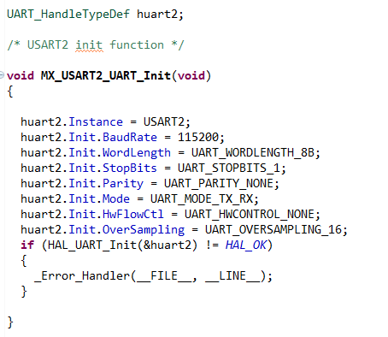
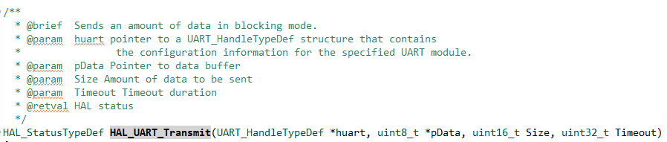
STM32 USART
Once everything is configure, we can generate the code. CubeMX will create the new configuration methods with all the parameters set using CubeMX
We can then transmit messages using the “HAL_UART_Transmit” function
7

Slide 8
Send a message when button is pressed

Slide 9
Send a message when button is pressed
Use the previously configured USART to send a message each time the pushbutton is pressed.
Use CubeMX to configure the pushbutton interrupt
Send “Hello from STM32” when such interrupt is triggered
9

Slide 10
ADC
ADC

Slide 11
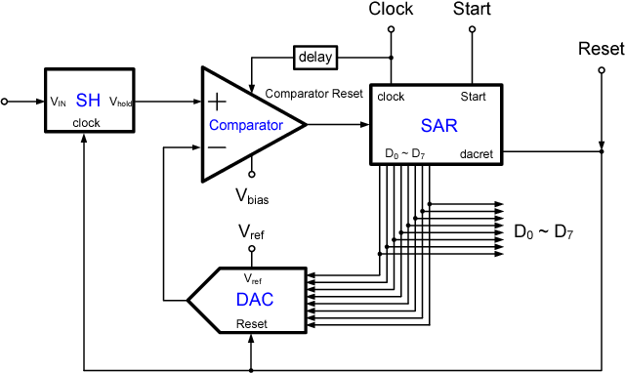
SAR ADC
11

Slide 12
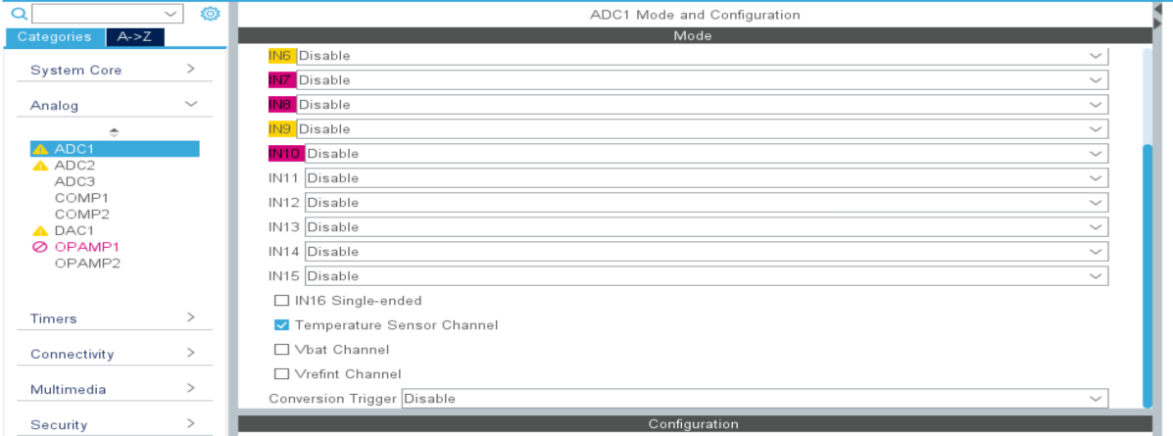
STM32 ADC
STM32 boards provide one, or multiples, ADCs connected to different channels, each one consisting of a 12-bit successive approximation A/D converter.
Among all, ADC1 provides two channels internally connected to a temperature sensor and to Vref.
12

Slide 13
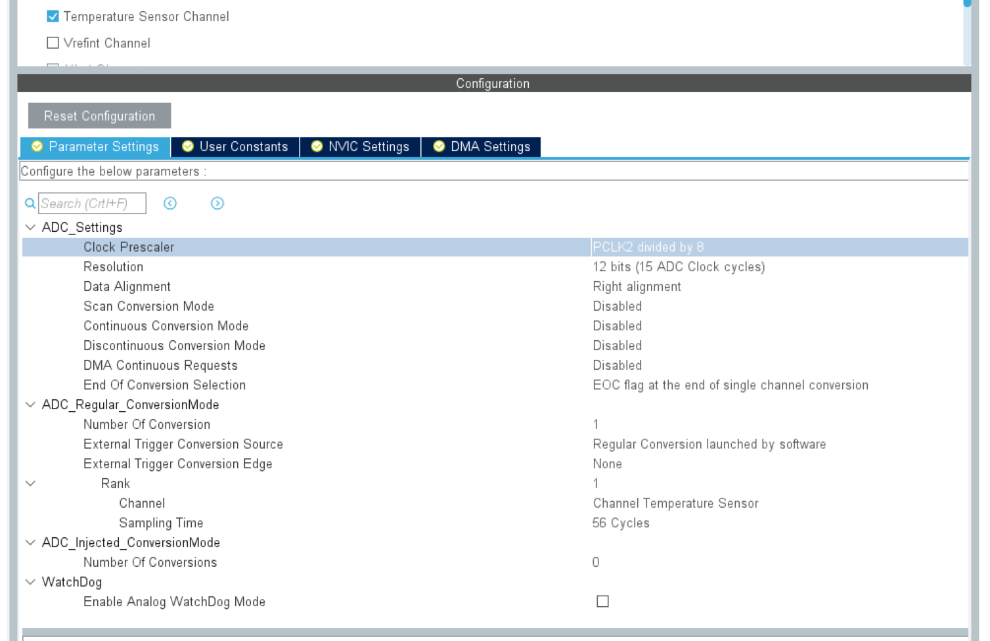
STM32 ADC
As for the other peripherals, CubeMX let us configure the ADC in a graphical way.
13

Slide 14
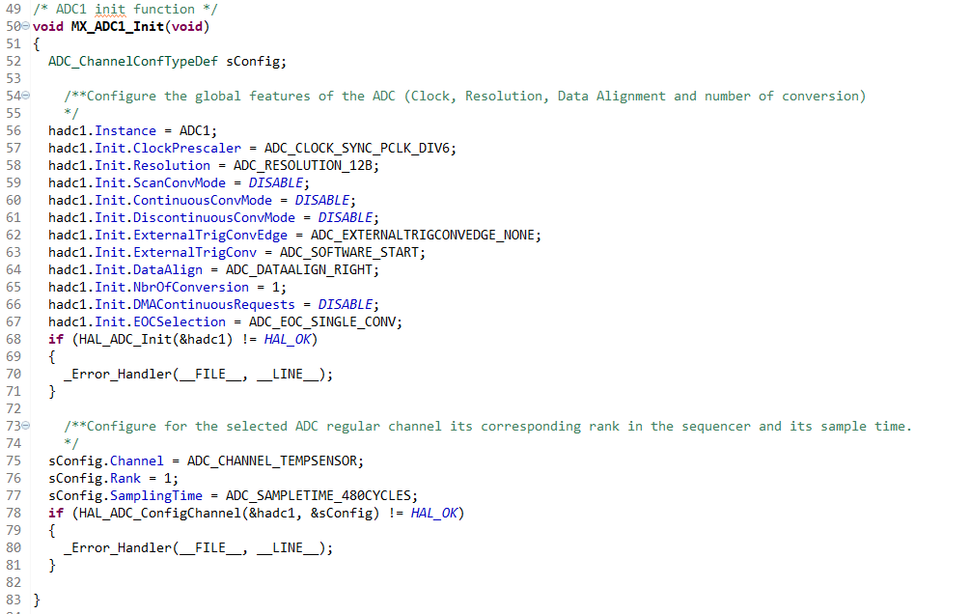
STM32 ADC
Once generated the code, the ADC configuration can be found inside the MX_ADC1_Init function
14

Slide 15
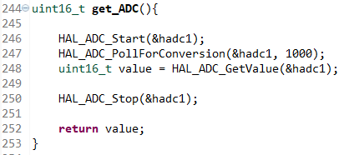

STM32 ADC
The ADC routine provides us the binary representation of the voltage sensed. Before having human readable numbers, we have to convert the raw data coming from the ADC.
We can create a simple method named get_ADC(), that takes care of starting the ADC, retrieve the value and then stops the ADC. The value returned can later be converted to a voltage value using the following formula(referenced to 3.3 V)
15

Slide 16
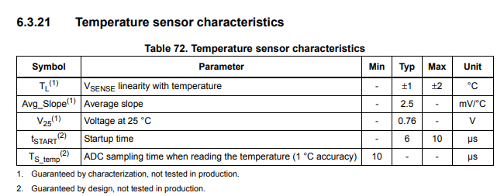

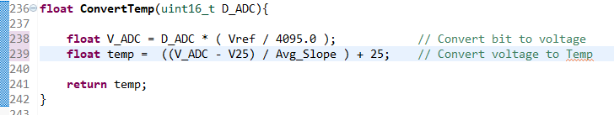
STM32 ADC
Once we have converted the ADC raw value, we have to convert this voltage to a Celsius value. MCU datasheet provides the parameters and the formula for conversion.
Vref and Avg_Slope must be defined accordingly !
16

Slide 17
Exercise 8
Send temperature readings through usart

Slide 18
Send temperature readings through usart
Use the previously configured USART and ADC as temperature sensor channel, send temperature readings through USART.
Use CubeMX to configure the USART
Use CubeMX to configure the ADC as temperature sensor channel
Send temperature readings through USART every 5 seconds.
18

Slide 19
Exercise 9
Visual thermometer

Slide 20
Visual thermometer
Starting from the last exercise, adjust the brightness of the led proportionally to the temperature readings.
Use CubeMX to configure the USART
Use CubeMX to configure the ADC as temperature sensor channel
Send temperature readings through USART every 5 seconds.
PLUS: adjust the led brightness proportionally to the temperature readings. [E.g. 25% if T < 20, 50% if 20 <= T <= 22 and 100% if T > 22]
20

